Slide 1
Capstone Project
Scholle IPN - Tomato Bags

Slide 2
Background and Motivation

Slide 3


Background
Seasonality (harvest season) within tomato bag sales and variability across years and products,
Difficult to plan for upcoming tomato bag sales season
Current forecasting methodology - historical sales (naive sARIMA model) with adjustments made based on sales team input
Forecasts up to 18 months ahead
~90% market share
Bag-in-Box packaging for tomato-containing products
Background
Baseline
Team Presentations
Ensemble
Integration
Insights
Notes:
Scholle IPN is a manufacturing company that has pioneered the production of Bag-in-Box packaging solutions
Tomato bags represent one of the company’s top manufactured items, with the company maintaining ~90% market share
Top 10 customers comprise majority of tomato bag sales
Wide range of products, customized film
The company has observed not only seasonality within tomato bag sales, but also variability across years and products
Each harvest season, Scholle sells between 1.7-2.1MM total tomato bags
Volatility in bag sales makes planning difficult, resulting in:
Lost revenue from product shortages
Excess inventory costs from an oversupply of product and materials
The company’s current forecasting methodology combines historical sales (naive sARIMA model) with adjustments made based on sales team input
Scholle forecasts up to 18 months ahead in order to plan for production

Slide 4
Tomato Yield Production Timeline
Planting Season
Harvest Season
January | February | March | April | May | June | July | August | September | October | November | December
Background
Baseline
Team Presentations
Ensemble
Integration
Insights

Slide 5
Research Purpose

Slide 6
Research Purpose
Improve upon the existing forecasting methodology
Social Media
Economics and Demographics
Related Products
Crop Yield
Ensemble Model
Final Model for Deployment
Background
Baseline
Team Presentations
Ensemble
Integration
Insights

Slide 7
Model Metrics

Slide 8
Model Metrics
sMAPE
Symmetric Mean Absolute Percent Error
RMSE
Root Mean Squared Error
Best Value: 0%
Worst Value: 100%
Reason to use: Allows us to understand error independent of scale.
Precaution: Non-symmetric
Best Value: 0
Worst Value: unbounded
Reason to use: Allows us to observe the amount of variability in the model.
Precaution: Units are squares of actuals
Background
Baseline
Team Presentations
Ensemble
Integration
Insights

Slide 9
Model Metrics
% Bias
Percent Forecast above Actual
Accuracy
Mean Accuracy between Forecast and Actual
Best Value: 50%
Worst Value: 0 or 100%
Reason to use: Allows us to understand if a model is consistently over- or under-estimating.
Precaution: Aggregate statistics
Best Value: 1
Worst Value: larger or smaller than 1
Reason to use: Allows us to directly compare forecast to actual.
Precaution: Accuracy > 1 is not good, simply implies the forecast was higher than the actual.
Background
Baseline
Team Presentations
Ensemble
Integration
Insights

Slide 10
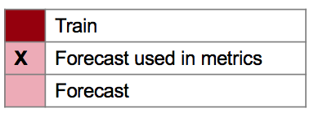
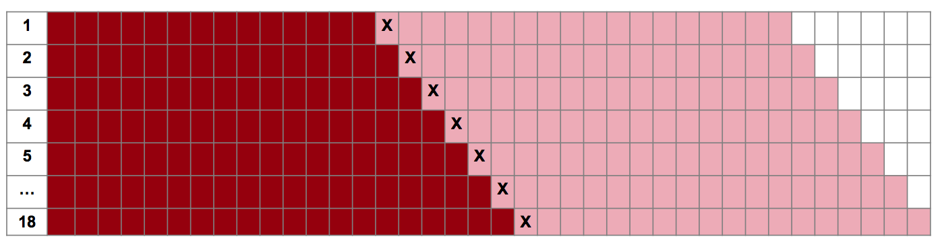
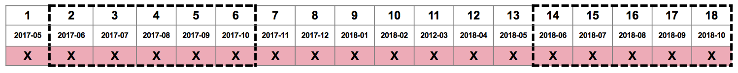
Model Metrics Calculation
Rolling Origin Cross Validation Illustration
Accuracy Metrics Computed on Harvest Month Forecasts
sMAPE, RMSE, Accuracy, Bias
Background
Baseline
Team Presentations
Ensemble
Integration
Insights

Slide 11
Scholle - Exploratory Data Analysis

Slide 12
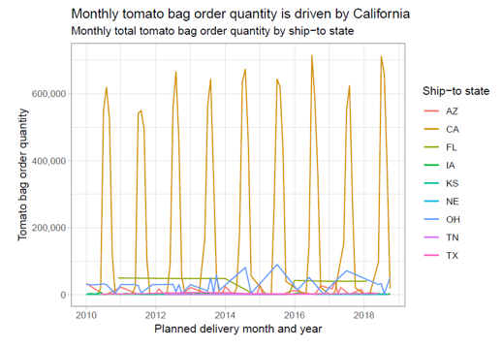
Data by Ship-To State and Date
Insights:
Overall, bag demand is driven by California where much of the tomato harvest comes from.
Other states with notable quantities are Arizona, Florida, Iowa, Kansas, Nebraska, Ohio, Tennessee, and Texas.
Background
Baseline
Team Presentations
Ensemble
Integration
Insights

Slide 13
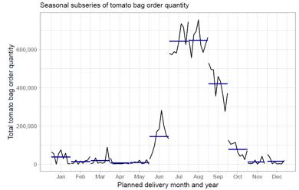
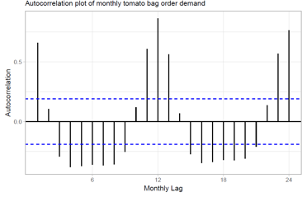
Seasonality, Autocorrelation, and Annual Variation
Monthly demand is fairly consistent year over year.
The time series is highly autocorrelated one year back (e.g. demand October of 2018 is very similar to October 2017)
Background
Baseline
Team Presentations
Ensemble
Integration
Insights

Slide 14
Scholle Baseline Model

Slide 15
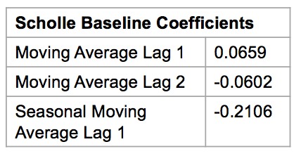

Tomato Baseline Model Summary - ARIMA(0,0,2)(0,1,1)[12]
Model Summary:
Traditional univariate time-series model
Considerations:
High data costs for seasonal models
As new data becomes available, diagnostic checking should
be repeated to ensure structure hasn’t broken down
Assumptions:
2 MA lags
Seasonal differencing
Model Results:
13.11% SMAPE and 66K RMSE provides baseline for all other multivariate models
Background
Baseline
Team Presentations
Ensemble
Integration
Insights

Slide 16
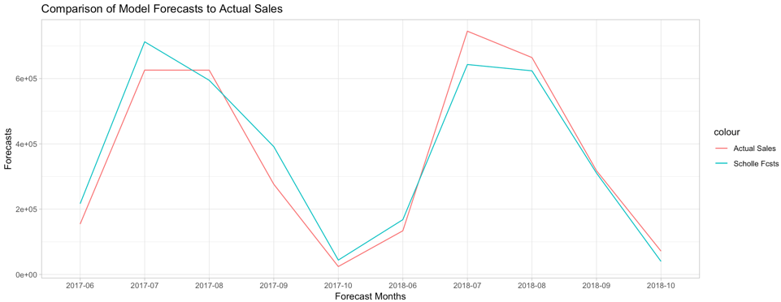
Tomato Baseline Model Forecasts
Background
Baseline
Team Presentations
Ensemble
Integration
Insights

Slide 17
Preliminary Analysis - raw files
Column | MetaData | Issues | Solution
Quantity | Numeric (-60K - 450K) | Negative & Zero | Remove bad rows
Fiscal Quarter | Ordinal (Q12010 - Q42018) |  | Drop
Company | Categorical (5 levels)
Top Most BP | Categorical (114 levels)
Business Partner | Categorical (144 levels) |  | Drop
Item Number | Categorical (182 levels)
Item Description | Categorical (182 levels) |  | Drop

Slide 18
Preliminary Analysis - raw files
Column | Metadata | Issues | Solution
Ship to State | Categorical (40 levels) | Missing values & shipments outside US | Impute; exclude
Ship to City | Categorical (146 levels) |  | Drop
Planned Delivery Date | Date (1/4/2010 - 11/2/2018)
Address | Text |  | Drop
Budget Qty | Numeric | NA values | Drop
Forecast Qty | Numeric | NA values | Drop
Line of Business | Categorical (4 levels)

Slide 19
Assumptions and Limitations
Drop negative & zero quantity rows (5,942 - 207 = 5,735 records)
US data only (5,735 - 339 = 5,336 )
Additional preparation was done to extract the state when not coded in the Ship_to_State column. See appendix for this logic.
Focus on Quantity as the predicted variable
Predictions will be modeled on Planned Delivery Data
Monthly aggregation

Slide 20
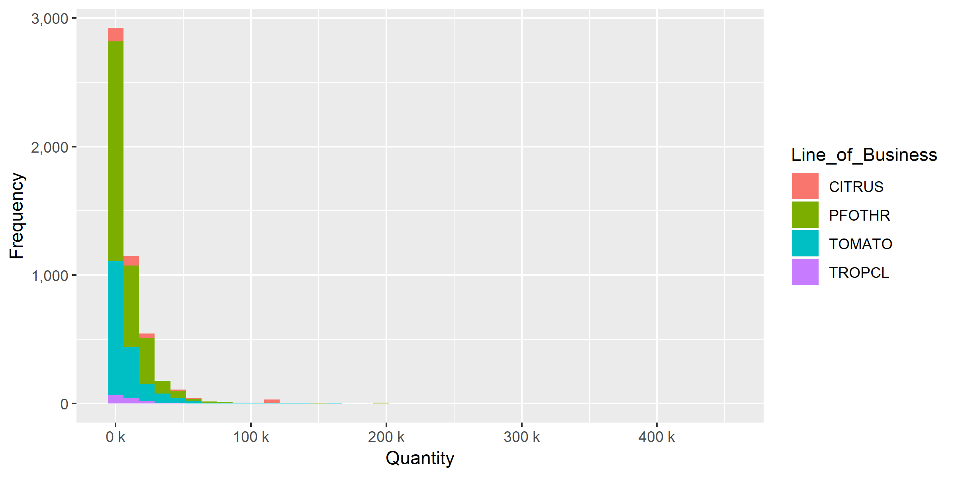
Preliminary Analysis - Quantity
The majority of sales fall under 50k with the largest sales exceeding 400k

Slide 21
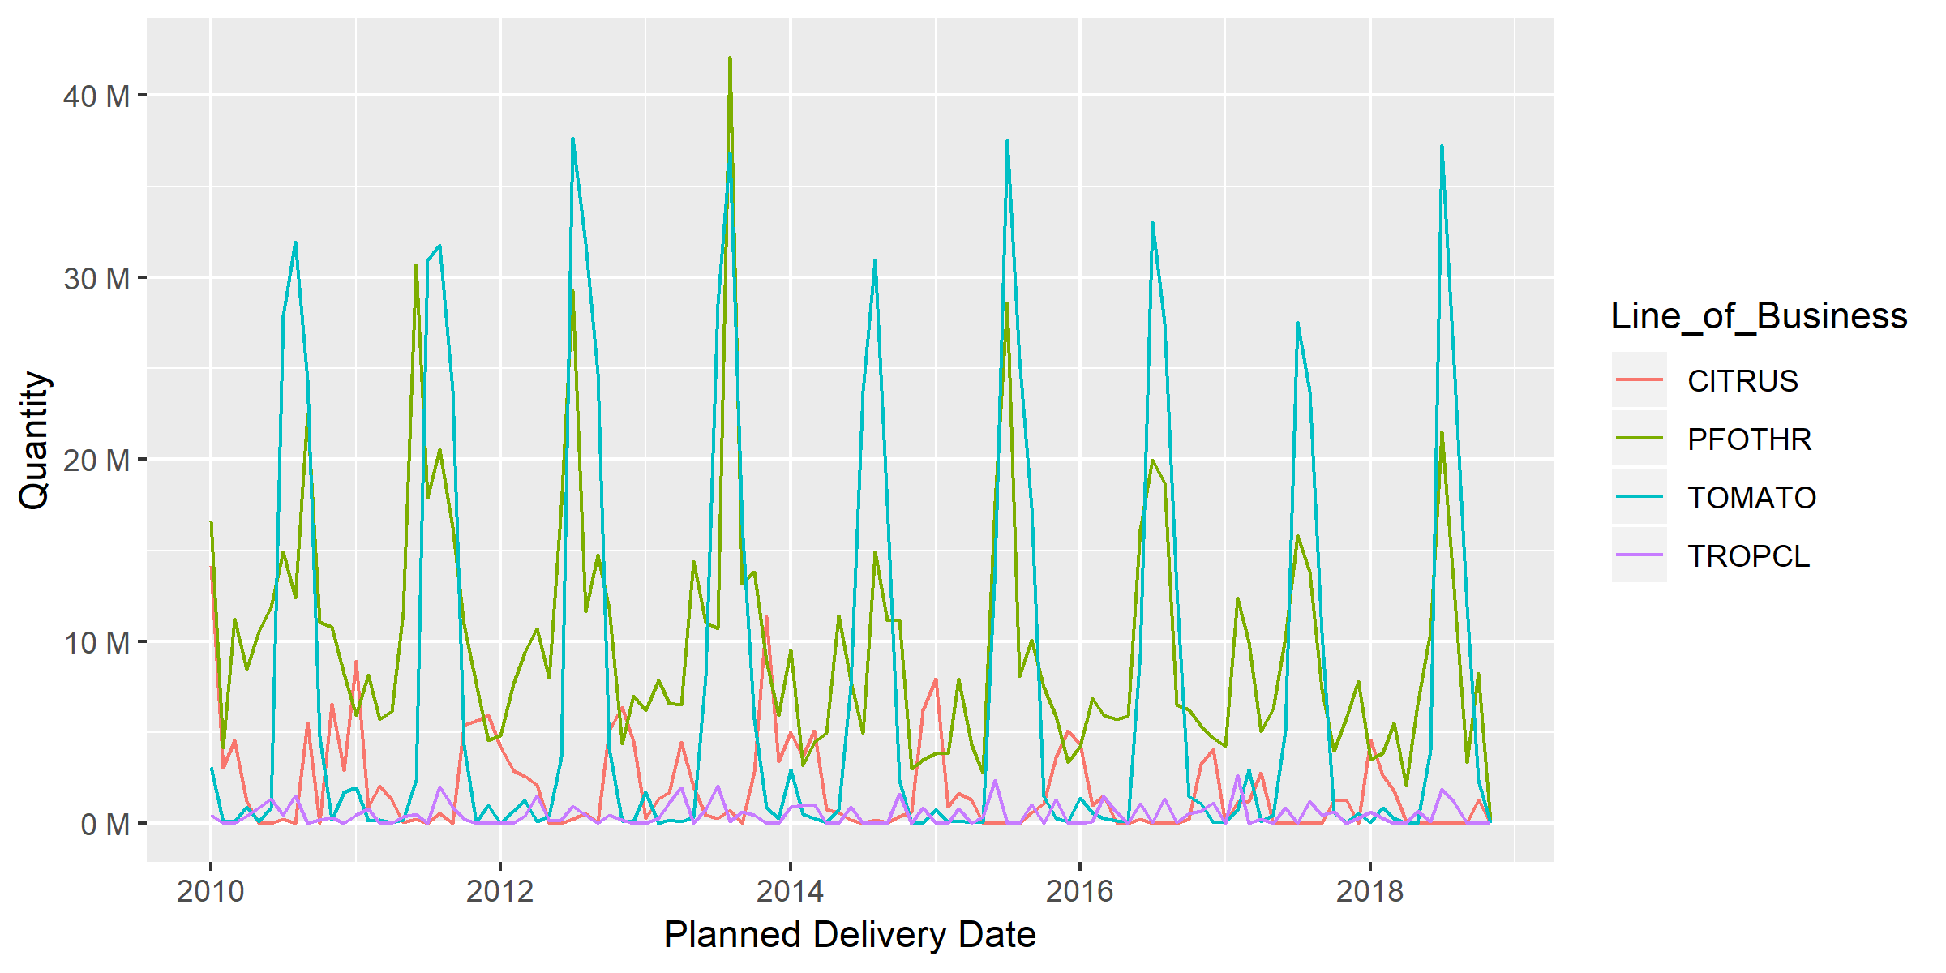
Quantity Statistics & Time-Series Plot
 | Quantity (overall by month)
Mean | 19.96 M
Min | 0.11 M
Max | 79.81 M
Median | 13.11 M
Standard Deviation | 16.42 M
Quantity aggregated to month by Line of Business
Notes:
Call out the min max month, year (confirm that we accumulated on a monthly basis?)

Slide 22
Exploratory Data Analysis
Top Business Partner
Item Number
State
City

Slide 23
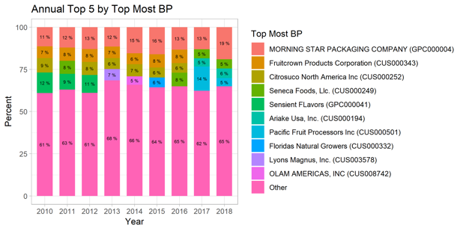
Top Business Partner
Percentage of Total Quantity per Year
Morning Star is consistently the largest Top Business Partner across time.

Slide 24
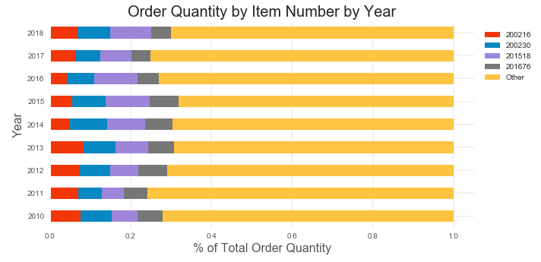
Item Number
Percentage of total Quantity by Item Number
Item number 201518 (purple) - most percentage of total throughout most of the years
Notes:
Keep everything in month . call out when did the min max happened (month, year)

Slide 25
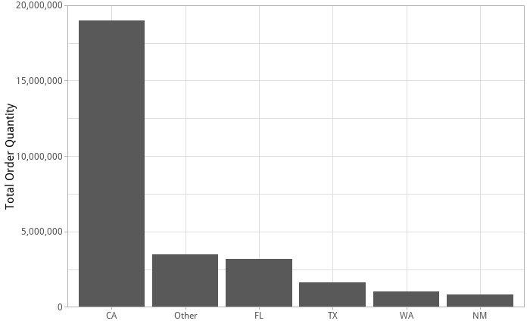
Total Order Quantity by State
California accounts for more demand than all other states combined.

Slide 26
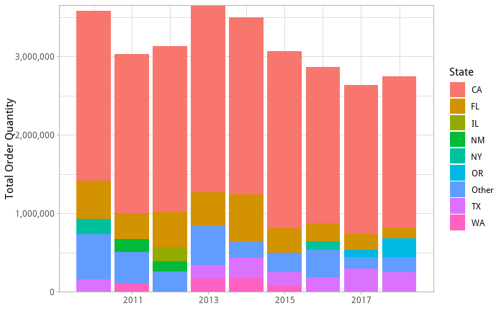
Order Quantity by State by Year
Orders peak in 2013, then fell to their lowest levels in 2017.

Slide 27
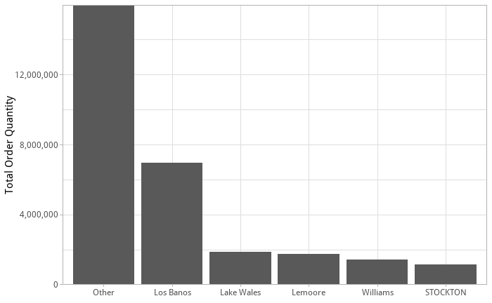
Total Order Quantity by City
Note that the city data is not clean, and cities can be represented multiple ways. We did not perform any cleanup on the cities, and we recommend an effort to clean up master data in the source system to streamline future analysis.

Slide 28
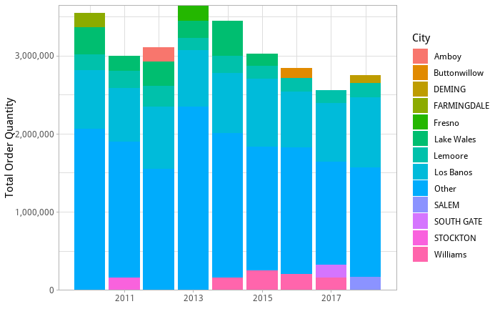
Total Order Quantity by City by Year
Note that the city data is not clean, and cities can be represented multiple ways. We did not perform any cleanup on the cities, and we recommend an effort to clean up master data in the source system to streamline future analysis.

Slide 29
Crop Yield External Datasets
Alisa Babikova, Anupriya Thirumurthy, Hyejeong Lee

Slide 30
Data Description
External Data Source | Frequency/Granularity | Range | Size | Variables
Historical Tomato Yield (USDA) | Yearly US only County level for CA and OH State level for CA, FL, IN, MI, NJ, ND, OH, PA, SC, TN, VA, other | 2000 - 2017 | 198 rows for county-level, 117 rows for state-level | Program, Year, Period, Geo level, State, County, Commodity (ex: tomatoes), Data Item (Conditions and Measurements), Domain (ex: Total), Value

Slide 31
Data Description
Weather Variables (DarkSky API) | Daily US only County level | 2000 - 2018 (Feb - Aug) | 150,140 rows | Precipitation, Sunlight, temperature, air pressure and dew point
Satellite Images (Google Earth API and/or USDS) HIstorical NDVI (USDA) | Inconsistent frequency US only County level | 2000 - 2018 (Feb - Aug) | TBD | NDVI value (-1 to 1) Image data

Slide 32
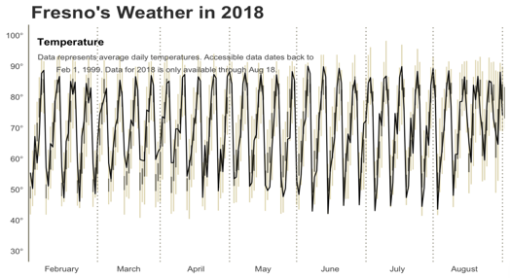

Assumptions & Limitations: Weather
Purpose: Using weather variables will help identify patterns that yield the highest tomato production.
Assumptions:
The weather is assumed to be constant across all the cities in a county
Limitations:
It takes a long time to download data due to limited API calls per day

Slide 33
Assumptions & Limitations: Historic Yield
Purpose: Once the tomato yield is predicted using weather and satellite variables, it will serve as an independent variable to predict tomato bag sales.
Assumptions:
Some counties produce more tomatoes than others
Total tomato yield for all counties would be reflective of larger factors such as weather
Limitations:
County-level data is only available for CA and OH ⇒ not reflective of all tomato-producing states

Slide 34
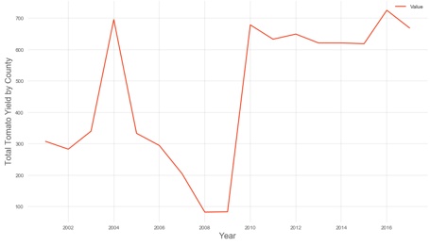
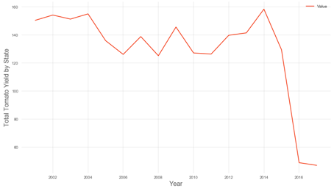
Total Yearly Tomato Yield (Aggregated)
County-Level State-Level
CA, OH CA, FL, IN, MI, NJ, ND, OH, PA, SC, TN, VA
Drop in 2008
Drop in 2014

Slide 35
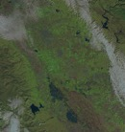
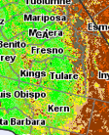

Assumptions & Limitations: Satellite Imagery
Purpose: NDVI index will help monitor the conditions of the crops throughout the season and predict NDVI values that yield the highest tomato production.
Satellite Images/NDVI Index:
Assumptions:
NDVI correlated with weather
Limitations:
No consistent frequency for historical images
Consolidate multiple open source libraries
NDVI and satellite image inputs, images rotated
Image: Californa Central Valley
Source: USDA and USDS

Slide 36
Crop Yield - Data Sources

Slide 37
External Data
 | Tomato Yield | Weather | NDVI
Description | Tomato yield per county | Temperature, Precipitation, Dew point, Sunlight, Air pressure per county | Average NDVI value per county
Data Source | US Department of Agriculture | DarkSky | US Department of Agriculture
Time Period | 2010-2017 | 2010-2018 | 2010-2018
Frequency | Yearly | Daily | Weekly
* NDVI (Normalized Difference Vegetation Index) quantifies vegetation ranging from -1 to +1
Background
Baseline
Crop Yield & Weather
Ensemble
Integration
Insights

Slide 38
Crop Yield - Variable Selection

Slide 39
Variables Selection
Weather (Min, Max, Avg)
Temperature Precipitation Dew Point Air Pressure Sunlight
Lasso regression
Stepwise regression
Random forest feature importance
Weather (Min, Max, Avg)
Maximum Temperature
NDVI
February to June
Correlation analysis
Stepwise regression
NDVI
May
Background
Baseline
Crop Yield & Weather
Ensemble
Integration
Insights

Slide 40
Variables Selection
Independent variables
Maximum Temperature, NDVI, Previous Year’s Tomato Yield
Dependent variable
Tomato Yield
 | Maximum Temperature | NDVI | Previous Year’s Tomato Yield
Target Variable Tomato Yield (2016) | 0.42 | -0.80 | 0.80
Target Variable Tomato Yield (2017) | 0.75 | -0.88 | 0.77
Table <Correlations between Target and Predictors>
Background
Baseline
Crop Yield & Weather
Ensemble
Integration
Insights

Slide 41
Crop Yield - Modeling Framework
Correction Model

Slide 42
Inputs for Crop Yield Model
Inputs for Scholle Bag Sales Model
Tomato Yield
(Yield 2018)
Scholle IPN Tomato Bag Sales
(Bags 2018)
+
Weather Data
(Feb-Jun 2019)
Tomato Bag Sale Model
Predicted tomato bag sales
(Bags 2019)
Crop Yield Model
+
+
Predicted tomato yield (Yield 2019)
NDVI Values
(Feb - Jun 2019)
Background
Baseline
Crop Yield & Weather
Ensemble
Integration
Insights

Slide 43
Model 1
Crop Yield Model

Slide 44
Crop Yield Model - Baseline and Challenger
Performance:
Random Forest Regressor outperforms challenger and baseline with a lower sMAPE of 2.38% , RMSE, % Bias and Mean Accuracy
Considerations:
High multicollinearity among the predictors
Restrictive response variable leads to small scale dataset
Model | sMAPE | RMSE (tons/acre) | Mean Accuracy | % Bias
Baseline (Linear Regression) | 2.69% | 2.90 | -0.28 | 3.23%
Challenger 1 (Ridge Regression) | 3.12% | 3.43 | -0.35 | 4.02%
Challenger 2 (Random Forest Regressor) | 2.38% | 2.42 | -0.20 | 2.07%
Background
Baseline
Crop Yield & Weather
Ensemble
Integration
Insights

Slide 45
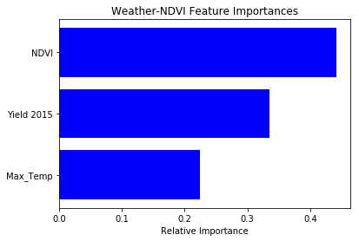
Winning Model - Crop Yield Model
Random Forest Regressor
Accommodates small datasets with high multicollinearity and potential non-linearity
Assumptions:
High ovefit from all models → minimize
Non-generalizable → weather varies
Suggestions:
Variable importances are not absolute values
Model | sMAPE | RMSE | Mean Accuracy | % Bias
Random Forest | 2.38% | 2.42 | -0.20 | 2.07%
Background
Baseline
Crop Yield & Weather
Ensemble
Integration
Insights

Slide 46
Model 2
Scholle Tomato Bag Sales Model

Slide 47
Scholle Tomato Bag Sales Model - Baseline and Challenger
Performance:
Outperforms Scholle baseline by 2.75% in terms of sMAPE
Considerations:
Uses predicted tomato yield from crop yield model
Limiting observations in the data due to restrictive response variable
Overfitting
Model | sMAPE | RMSE (bags) | Mean Accuracy | % Bias | R squared
Scholle only Baseline | 13.11% | 66,306 | -1.39 | 0.50 | -
Baseline (Linear Regression) | 10.36% | 73,491 | 6.52 | 18% (-ve) | Train: 0.99 Test: 0.92
Challenger (Random Forest) | 11.6% | 112,674 | 8.19 | 13% (-ve) | Train: 0.93 Test: 0.83
Background
Baseline
Crop Yield & Weather
Ensemble
Integration
Insights

Slide 48
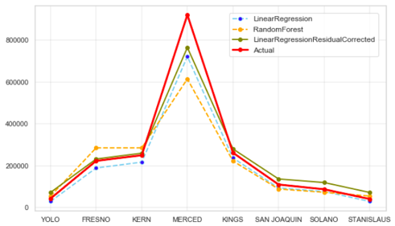
Winning Model - Scholle Tomato Bag Sales Model
Actual vs Forecasted Quantity
Linear Regression
Assumptions:
Linear relationship is observed between tomato yield and tomato bag sales
Insights:
Merced county has the highest predicted tomato bag sales quantity
Background
Baseline
Crop Yield & Weather
Ensemble
Integration
Insights

Slide 49
Model Integration and Monitoring

Slide 50
Scholle Infrastructure
External Data Sources
Flat files
Scholle Database
Production
Scholle Database
Testing
Data
Individual Tomato Models
Replicate
Forecasts
Full Ensemble Model
AWS Node
Background
Baseline
Team Presentations
Ensemble
Integration
Insights

Slide 51
Model Output Format
Ensemble Model
Crop Yield & Weather Model
Month | Forecasted Bag Quantity
May 2019 | 31,392
Jun. 2019 | 184,678
Jul. 2019 | 641,284
Aug. 2019 | 664,087
Sept. 2019 | 307,933
Oct.2019 | 48,379
….
Oct.2020 | 20,807
 | 2018 | 2019
Tomato Yield avg tons/acre | 46.6 | 46.8
Tomato Bags total quantity in millions | 1.9 | 2.3
Background
Baseline
Team Presentations
Ensemble
Integration
Insights

Slide 52
Model Monitoring - Crop Yield Model
sMAPE & RMSE
Monitor based on the previous year’s prediction, compare the previous year’s prediction with this year’s prediction
If the error metrics increase/decrease from the previous year’s, script sends a notification message
Historical Data for Monitoring sMAPE | Annual Launch Point | Annual Prediction
2018 Prediction | June 2019 | 2019 Prediction
2019 Prediction | June 2020 | 2020 Prediction
Background
Baseline
Team Presentations
Ensemble
Integration
Insights

Slide 53
Insights and Takeaways

Slide 54
Data Insights
Crop & Weather
NDVI for May - most representative of an annual yield
Maximum temperature and previous year’s yield have the positive impact on this year’s yield
Background
Baseline
Team Presentations
Ensemble
Integration
Insights

Slide 55
Recommendations
Future Work
Use forecasts from most recent model run each month
Limit production planning to 1 harvest season in advance
Check with crop yield-weather model for changes in yield and bag quantity
Crop yield-weather model as a correction model for the forecast generated by the ensemble model
Background
Baseline
Team Presentations
Ensemble
Integration
Insights

Slide 56
Thank You!

Slide 57
Appendix

Slide 58
Background
Scholle IPN is a manufacturing company that has pioneered the production of Bag-in-Box packaging solutions
Tomato bags represent one of the company’s top manufactured items, with the company maintaining ~90% market share
Top 10 customers comprise majority of tomato bag sales
Wide range of products, customized film
The company has observed not only seasonality within tomato bag sales, but also variability across years and products
Each harvest season, Scholle sells between 1.7-2.1MM total tomato bags
Volatility in bag sales makes planning difficult, resulting in:
Lost revenue from product shortages
Excess inventory costs from an oversupply of product and materials
The company’s current forecasting methodology combines historical sales (naive sARIMA model) with adjustments made based on sales team input
Scholle forecasts up to 18 months ahead in order to plan for production
Background
Baseline
Team Presentations
Ensemble
Integration
Insights
Notes:
Scholle IPN is a manufacturing company that has pioneered the production of Bag-in-Box packaging solutions
Tomato bags represent one of the company’s top manufactured items, with the company maintaining ~90% market share
Top 10 customers comprise majority of tomato bag sales
Wide range of products, customized film
The company has observed not only seasonality within tomato bag sales, but also variability across years and products
Each harvest season, Scholle sells between 1.7-2.1MM total tomato bags
Volatility in bag sales makes planning difficult, resulting in:
Lost revenue from product shortages
Excess inventory costs from an oversupply of product and materials
The company’s current forecasting methodology combines historical sales (naive sARIMA model) with adjustments made based on sales team input
Scholle forecasts up to 18 months ahead in order to plan for production

Slide 59
Research Purpose
Create an ensemble model to forecast tomato bag demand using crop yield & weather patterns to predict sales
Identify factors that most significantly predict demand
Implement the model and integrate it into Scholle’s system
Provide the company with the framework behind the model
Background
Baseline
Team Presentations
Ensemble
Integration
Insights

Slide 60
Model Deployment Timeline
Set-Up Phase
Testing Phase
Production Phase
Model Code Upload in Github
Model Testing
Code Modification for Database Output
Software Architecture Documentation
Knowledge Transfer
User Manual Creation
Scholle Environment Creation
Create First Forecast
Database Replication for Testing
May 19
June 1
June 15
June 29
Background
Baseline
Team Presentations
Ensemble
Integration
Insights

Slide 61
Data Insights - Expanded
NDVI values from May are most representative of an annual yield
Maximum temperature and previous year’s yield have the most consistent impact on this year’s yield
Background
Baseline
Team Presentations
Ensemble
Integration
Insights

Slide 62
Recommendations & Future Work - Expanded
While the model can forecast up to 2 harvest seasons, Scholle should be aware of model performance deterioration across longer horizons
Production and manufacturing planning based on model predictions should be limited to 1 harvest season
Crop yield - weather model as a correction model for the forecast generated by the ensemble model
Background
Baseline
Team Presentations
Ensemble
Integration
Insights

